Slide 1
Unit 3
PROJECTIONS OF PLANES
AND PROJECTIONS OF SOLIDS

Slide 2
PROJECTIONS OF PLANES

Slide 3
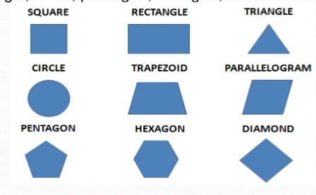
A plane is a two dimensional object having length and breadth only. Its thickness is always neglected. Various shapes of plane figures considered such as square, rectangle, circle, pentagon, hexagon, etc.

Slide 4
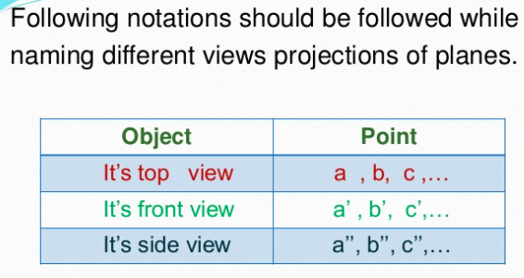
Notation of object in Space

Slide 5
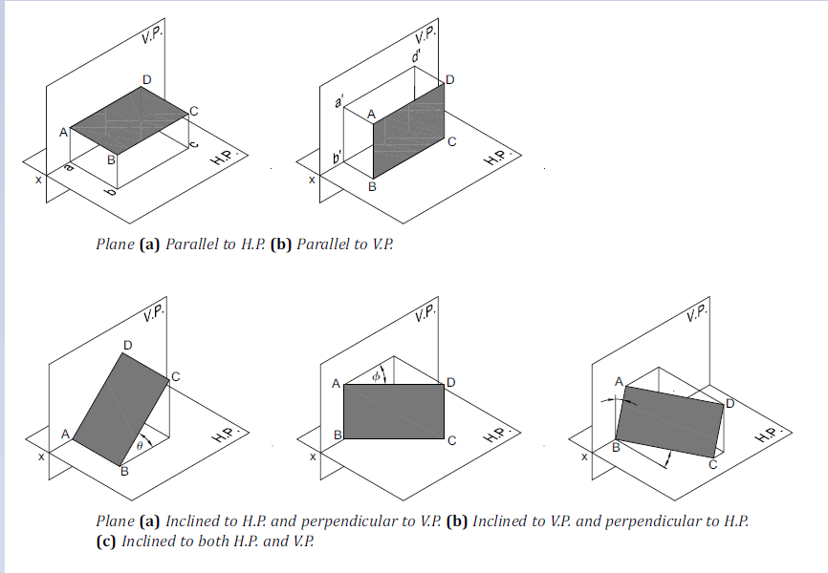

Slide 6
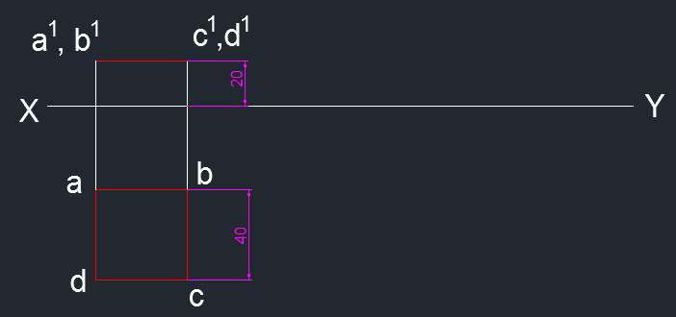
PLANE PARALLEL TO H.P.
1. A Square plane of side 40 mm has its surface parallel to and 20 mm above the H.P. Draw its projections when a) a side is parallel to the H.P. b) one side is inclined at 30° to the V.P.
SOL. a)
Draw XY line.
From the question, the Square plane is parallel to H.P. SO, true shape (square) will be in the top view and shortest shape (line) will be in the front view.
Draw a square of side 40 mm using Rectangle command Rec.
Draw projection lines from a, d to front view ( above XY line) using line command L.
Create a line at a distance 20 mm from XY line using offset command O. Trim the extra lines using trim TR.
Mark the annotations using MTEXT command.
Mark the dimensions using DIMLIN command.

Slide 7
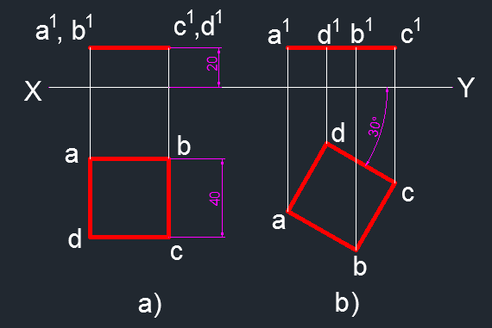
SOL. B)
8. Draw a Square at an angle of 30° from XY line with 40 mm side using REC command.
9. Draw the projection lines from square (F.V) to line (T.V). Using line command L.
10 . Mark the annotations using MTEXT command.
11. Mark the dimensions using DIMANG command.

Slide 8
PLANE PARALLEL TO V.P.
2. A Hexagonal plane of side 25 mm has its surface parallel to and 20 mm in front of V.P. Draw its projections when a side is a) parallel to the H.P. b) perpendicular to the H.P. C) inclined at 45° to the H.P.
SOL. a)
Draw XY line.
From the question, the Hexagonal plane is parallel to V.P. SO, true shape (hexagon) will be in the front view and shortest shape (line) will be in the top view.
Draw a Hexagon plane of side 25 mm with side parallel to H.P. using polygon command POL.
Draw projection lines from a‘, b‘, c‘, d‘, e‘, f‘ to top view ( below XY line) using line command L.
Create a line at a distance 20 mm from XY line using offset command O. Trim the extra lines using trim TR.
Mark the annotations using MTEXT command.
Mark the dimensions using DIMLIN command.

Slide 9
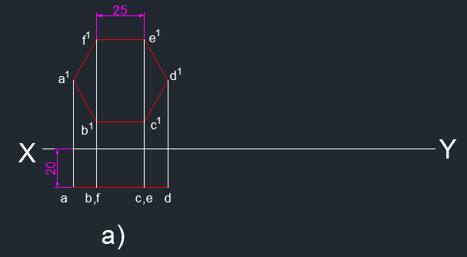

Slide 10
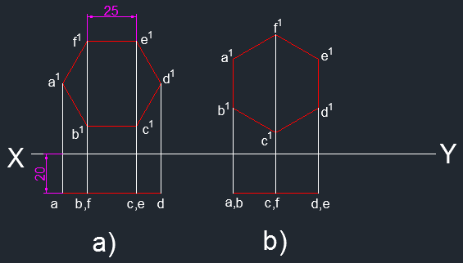
SOL. b)
8. the Hexagonal plane is parallel to V.P. SO, true shape (hexagon) will be in the front view and shortest shape (line) will be in the top view.
9. Draw a Hexagon plane of side 25 mm with side perpendicular to H.P using polygon command POL.
10.Draw projection lines from a‘, b‘, c‘, d‘, e‘, f‘ to top view ( below XY line) using line command L.
11.Create a line at a distance 20 mm from XY line using offset command O. Trim the extra lines using trim TR.
12. Mark the annotations using MTEXT command.
13. Mark the dimensions using DIMLIN command.

Slide 11
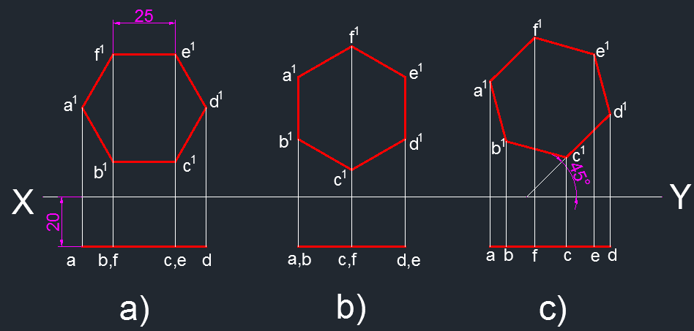
SOL. C)
14. Draw a line at an angle of 45° from XY line using line command L.
15. Draw a hexagon with 25 mm side on the inclined line using POL command. In POL command, take Edge option.
16. Draw the projection lines from hexagon (F.V) to line (T.V). Using line command L.
17. Mark the annotations using MTEXT command.
18. Mark the dimensions using DIMANG command.

Slide 13
RULES TO DRAW TRUE SHAPE
Side in HP Edge in HP
Corner in HP
Surface inclined to HP
Plane inclined to HP
Edge parallel to HP
TRUE SHAPE TO BE DRAWN BELOW XY LINE
Side in VP Edge in VP
Corner in VP
Surface inclined to VP
Plane inclined to VP
Edge parallel to VP
TRUE SHAPE TO BE DRAWN ABOVE XY LINE

Slide 14
TRUE LENGTH
Side in HP/VP Edge in HP/VP
TRUE LENGTH TO BE DRAWN IN XY
Edge parallel to HP/VP
Side parallel to HP/VP
TRUE LENGTH TO BE DRAWN PARALLEL TO XY

Slide 15
TRUE LENGTH
Surface inclined to HP Plane inclined to HP
TRUE LENGTH IS INCLINED AT AN ANGLE θ
ABOVE XY
Surface inclined to VP Plane inclined to VP
TRUE LENGTH IS INCLINED AT AN ANGLE ϕ
BELOW XY

Slide 16
TRUE LENGTH
θ
TRUE SHAPE
TOP VIEW

Slide 17
TRUE SHAPE
FRONT VIEW
TRUE LENGTH
ϕ

Slide 18
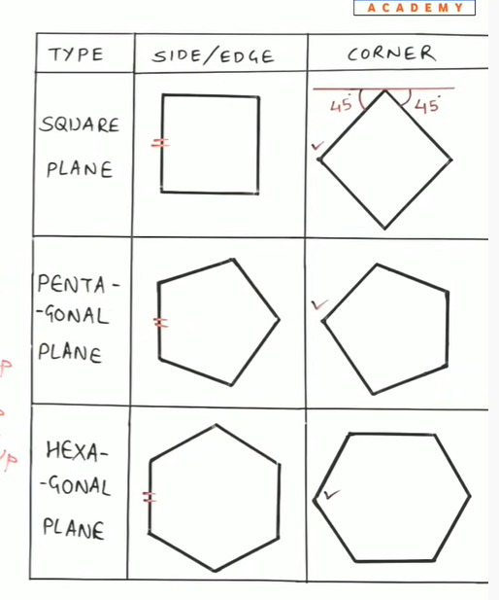

Slide 19
PLANE INCLINED TO H.P AND PERPENDICULAR TO VP.
When the surface of the plane is inclined at θ to HP and perpendicular to VP, the projections are obtained in two stages.
In the first stage, the plane is assumed to lie on the H.P. The true shape of the plane is viewed in the top view and a straight line lying on xy in the front view.
In the second stage, the plane is tilted at θ to xy.
The final top view is obtained by joining the points of intersection of the vertical projectors of the corners from the front view with the horizontal projectors of the corners from the top view of the preceding stage.

Slide 20
3. A hexagonal plane of side 30 mm has an edge on the H.P. The surface is inclined at 45° to the H.P. and perpendicular to the V.P. Draw its projections.
SOL.
Draw XY line.
2. The plane has an edge on the H.P., so consider that initially the hexagonal placed on the H.P with side AB perpendicular to the V.P.
First Stage
3. Draw a hexagon abcdef of length 30mm keeping ab perpendicular to xy to represent the top view using Polygon command POL. In polygon command, use Edge Option.
4. Dimension the edge using DIMLIN command. Mark a, b, c, d, e, f using MTEXT command.
5. Project the corners to xy using Line command L. Mark the respective points as a’, b’, c’, d’, e’, f’. using MTEXT command.
6. Draw a line joining the points using Line command L to represent the front view.

Slide 21
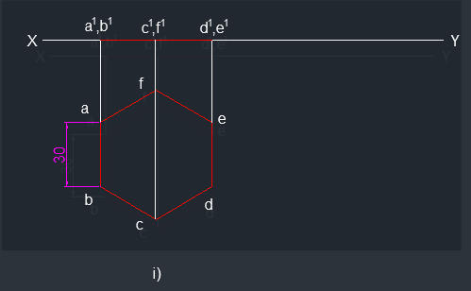

Slide 22
Second Stage
7. Measure the distances ae and af.
8. Draw a line at an angle of 45° to xy with length equal to ae (@51.96<45) using Line command L. Mark a point on the line with length equal to af (25.46mm) using Point command PO. Dimension the angle using DIMANG command.
9. Mark the respective points as a’, b’, c’, d’, e’, f’. using MTEXT command.
10. Draw the projection lines (Vertical lines from front view) and locus lines (Horizontal lines from Top view) using Line command L.
11. Mark the points as a, b, c, d, e, f at the corresponding intersections of projectors and locus lines using MTEXT command.
12. Draw lines joining the points using Line command L to represent the final top view.

Slide 23
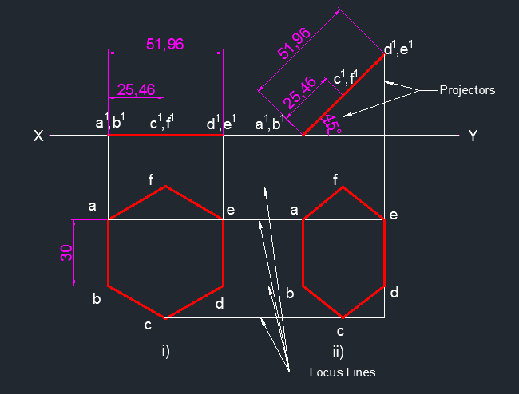

Slide 24
PLANE INCLINED TO V.P AND PERPENDICULAR TO H.P
When the surface of the plane is inclined at f to the V.P. and perpendicular to the H.P., the projections are drawn in two stages.
In the first stage, the plane is assumed to lie in the V.P. The true shape of the plane is viewed in the front view and a straight line lying on xy in the top view.
In the second stage, the plane is tilted at f to the V.P. The top view is redrawn inclined at f to the xy.
The final front view is obtained by joining the points of intersection of the vertical projectors of the corners from the top view with the horizontal projectors of the corners from the front view of the preceding stage.
Note 1: If the plane has a side parallel to the V.P. or in the V.P., then keep an edge of the plane perpendicular to xy in the front view of the first stage.
Note 2: If the plane has a corner in the V.P., then keep the line joining a corner and the centre of the plane parallel to xy in the front view of the first stage.

Slide 25
4. A hexagonal plane of side 30 mm has an corner in the V.P. The surface of the plane is inclined at 45° to the V.P. and perpendicular to the H.P. Draw its projections when the diagonal through the corner in the V.P. is parallel to the H.P.
SOL.
Draw XY line.
2. The plane has a corner in the V.P., so consider plane ABCDEF is placed on the V.P with line joining the corner A to the centre of the plane parallel to the V.P.
First Stage
3. Draw a hexagon a'b'c'd'e'f' of length 30mm keeping a‘d’ parallel to xy to represent the front view using Polygon command POL. In polygon command, use Edge Option.
4. Dimension the edge using DIMLIN command. Mark a‘, b‘, c‘, d‘, e‘, f' using MTEXT command.
5. Project the corners to xy using Line command L. Mark the respective points as a, b, c, d, e, f. using MTEXT command.
6. Draw a line joining the points using Line command L to represent the top view.

Slide 26
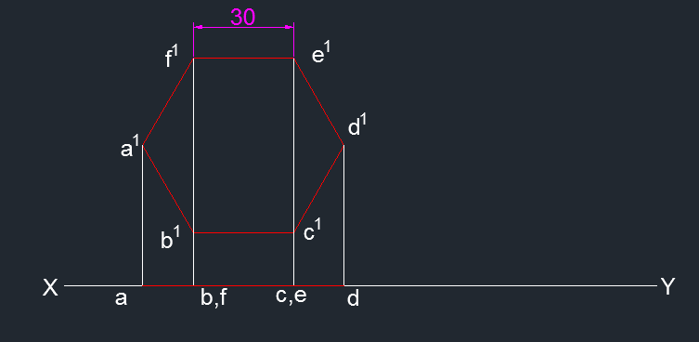

Slide 27
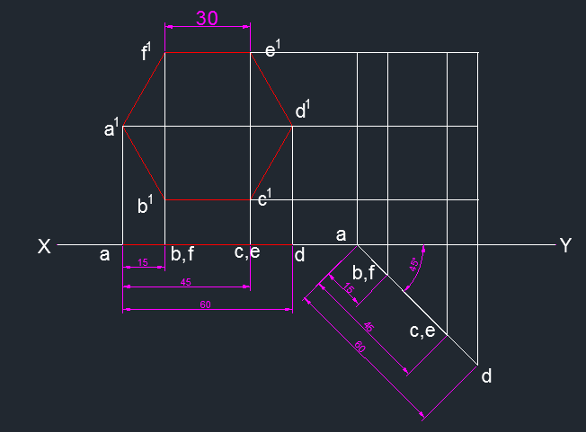
Second Stage
7. Measure the distances ab, ac and ad.
8. Draw a line at an angle of 45° to xy with length equal to ad (@60<315) using Line command L. Mark points on the line with lengths equal to ab (15mm) and ac (45mm) using Point command PO. Dimension the angle using DIMANG command.
9. Mark the respective points as a, b, c, d, e, f. using MTEXT command.
10. Draw the projection lines (Vertical lines from front view) and locus lines (Horizontal lines from Top view) using Line command L.

Slide 28
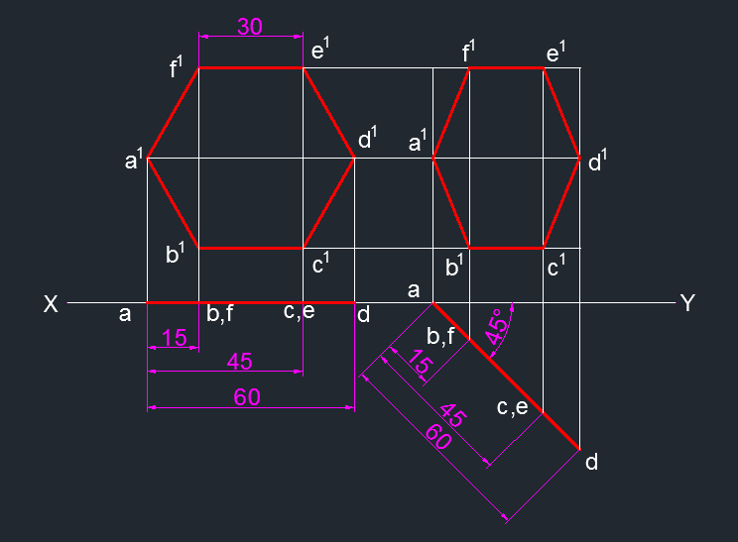
11. Mark the points as a', b', c', d', e', f' at the corresponding intersections of projectors and locus lines using MTEXT command.
12. Draw lines joining the points using Line command L to represent the final front view.

Slide 29
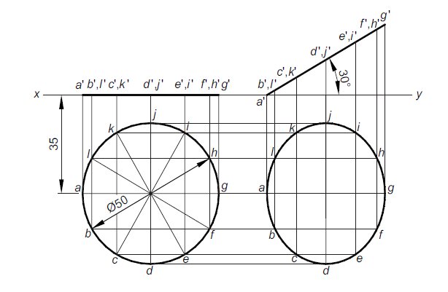
PROBLEMS - INCLINED TO ONE PLANE
5. A circular plane of diameter 50 mm is resting on a point of the circumference on the H.P. The plane is inclined at 30° to the H.P. and its centre is 35 mm in front of the V.P. Draw its projections.
Note: Divide the circle in to 12 equal parts.

Slide 30
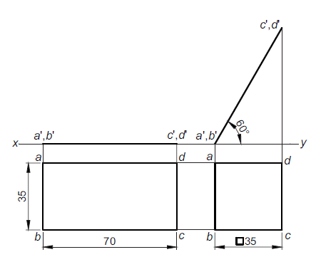
PROBLEMS - INCLINED TO ONE PLANE
6. A rectangular plane of sides 70 mm and 35 mm has a shorter side on the H.P. The
surface of the plane is inclined at 60° to the H.P. and perpendicular to the V.P. Draw its projections.

Slide 31
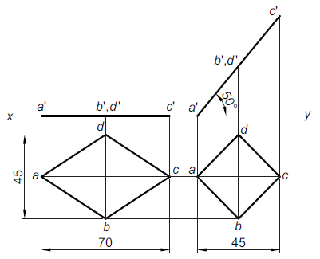
PROBLEMS - INCLINED TO ONE PLANE
7. A rhombus of diagonals 70 mm and 45 mm is placed on an end of the major diagonal
on the H.P. Its surface is inclined at 50° to the H.P. and perpendicular to the V.P. Draw its projections.

Slide 32
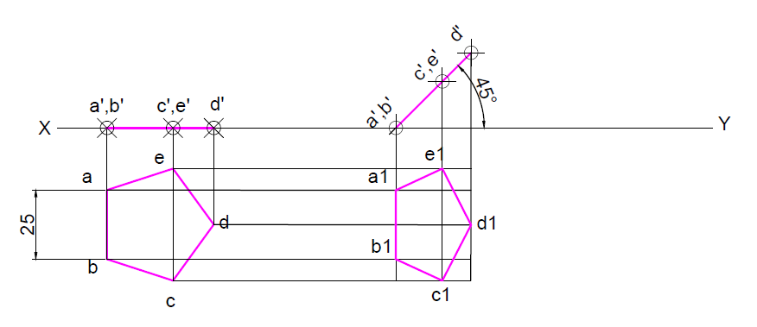
PROBLEMS - INCLINED TO ONE PLANE
8. A regular pentagon of side 25mm has one side on the ground its plane is inclined 45deg to the HP and perpendicular to the VP. Draw its projections.

Slide 33
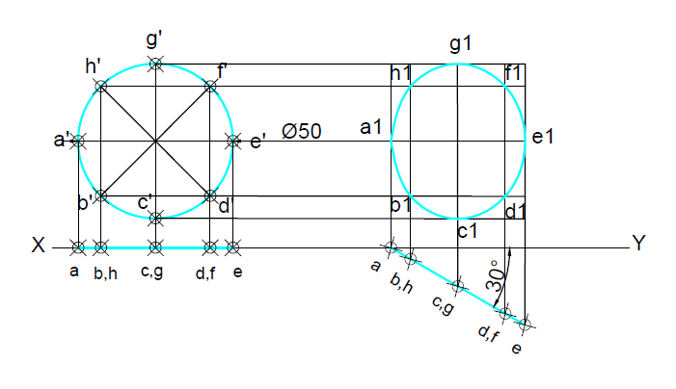
PROBLEMS - INCLINED TO ONE PLANE
9. A circular plane of diameter 50mm is resting on a point on the circumference on the VP. The plane is inclined at 30deg to the VP and the centre is 45mm above the HP. Draw its projections.

Slide 34
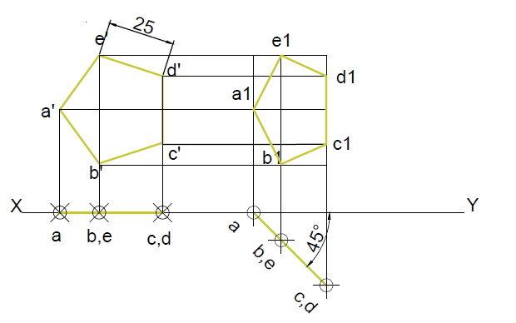
PROBLEMS - INCLINED TO ONE PLANE
10. A regular pentagon of 25mm side has corner on the VP its plane is inclined 45deg to VP. Draw its projections.

Slide 35
PLANE INCLINED TO BOTH THE REFERENCE PLANES (edge in the H.P.)
11. A rectangular plane of edges 35 mm and 70 mm is resting on an edge in the H.P. The surface is inclined to the H.P. such that the top view appears as a square. Draw its projections when the edge resting on the H.P. is inclined at 30° to the V.P.
SOL.
Draw XY line.
2. A rectangular plane is inclined to the H.P. and perpendicular to the V.P. can appear as a square in the top view, when the shorter edge of the plane is in the H.P. or parallel to H.P.
First Stage
3. Draw a rectangle abcd of length 70mm X 35mm keeping side ab perpendicular to xy to represent the top view using Rectangle command REC.
4. Dimension the edges using DIMLIN command. Mark a, b, c, d using MTEXT command.
5. Project the corners to xy using Line command L. Mark the respective points as a', b', c', d', using MTEXT command.
6. Draw a line joining the points using Line command L to represent the front view.

Slide 36
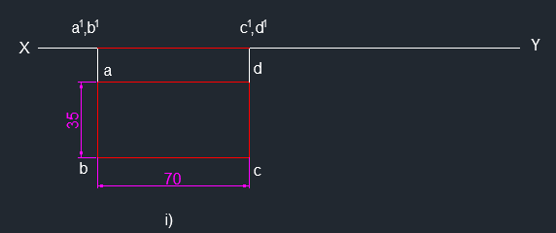

Slide 37
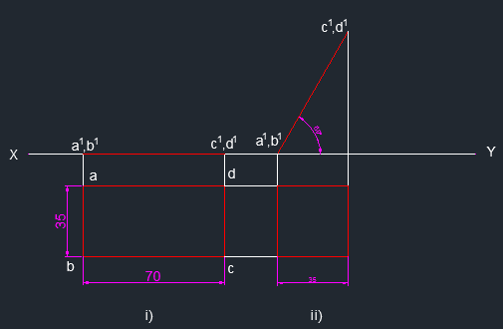
Second Stage
7. Draw al line with length 70mm at an angle of 60° from xy (@70<60) using Line command L.
Draw the horizontal locus lines from points a, b, c and d and vertical projection lines using Line command L.
Draw a square abcd at the intersection of projection and locus lines using Line command L. Dimension using DIMLIN command.
10. Mark the respective points as a, b, c, d using MTEXT command.

Slide 38
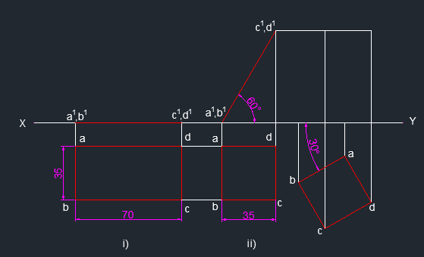
Third Stage
11. Copy the square from second stage using Copy command CO.
12. Rotate the square with an angle 210° with xy using Rotate command RO. Dimension the angle using DIMANG command. Mark the respective points as a, b, c, d using MTEXT command.
13. Draw the projection lines to front view from a, b, c, d using Line command L.

Slide 39
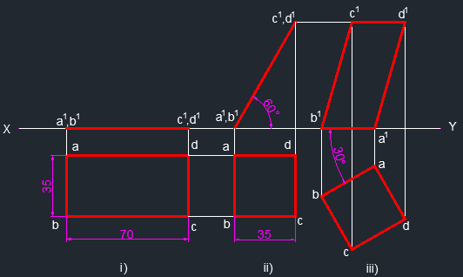
14. Draw the lines a’b’, b’c’, c’d’ and d’a‘ at the intersection points of projection lines and locus lines using Line command L.
15. Mark the respective points as a', b', c', d', using MTEXT command.

Slide 40
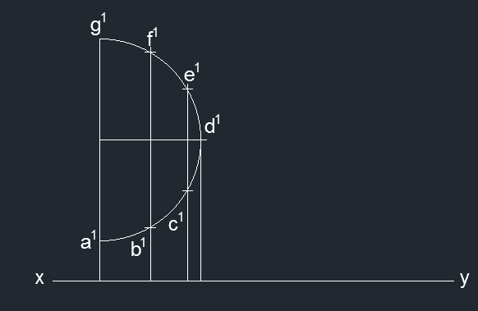
PLANE INCLINED TO BOTH THE PLANES (edge in the V.P.)
12. A Semi circular plane of diameter 70 mm has its straight edge on the V.P. and inclined at 30° to the H.P. Draw the projections of the plane when its surface is inclined at 45° to the V.P.
SOL.
Draw xy line.
A semi circle has its straight edge on the V.P. can appear as a semi circle in the front view.
First Stage
3. Draw a line of length 70mm using Line command L. Draw an arc with 35mm radius with line middle point as centre to represent the front view.
4. Divide the semi circle in to 6 equal parts using DIV command. Mark a‘, b‘, c‘, d‘, e‘, f‘, g' using MTEXT command. Dimension using DIMLIN command.

Slide 41
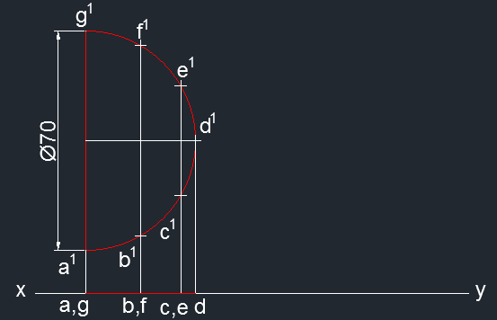
5. Draw vertical projection lines from a‘, b‘, c‘, d‘, e‘, f‘, g‘ to xy line.
6. Mark a, b, c, d, e, f, g using MTEXT command at the respective intersection points.
7. Draw a line by joining the points to represent the top view using Line command L.

Slide 42
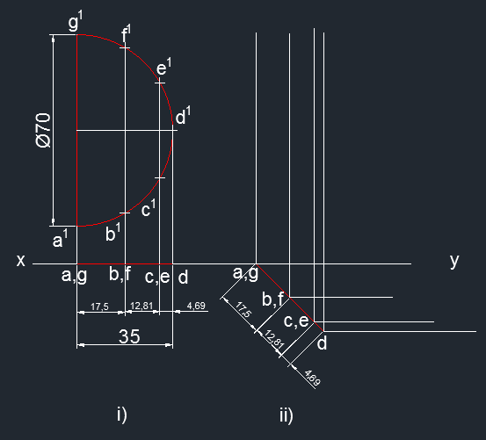
Second Stage
8. Measure the distances ab, bc, cd using DIMLIN command.
Draw a line of length 35mm (equal to ad) at an angle of 315° (@35<315)
Create points on the ad line with distance equal to 17.5mm, 12.81mm, 4.69mm. Use Parametric – Dimensional Constraints – Aligned – Change to required dimensions.
Dimension using DIMALI command.
Draw projection lines from a, b, c, d, e, f, g to front view using Line command L.

Slide 43
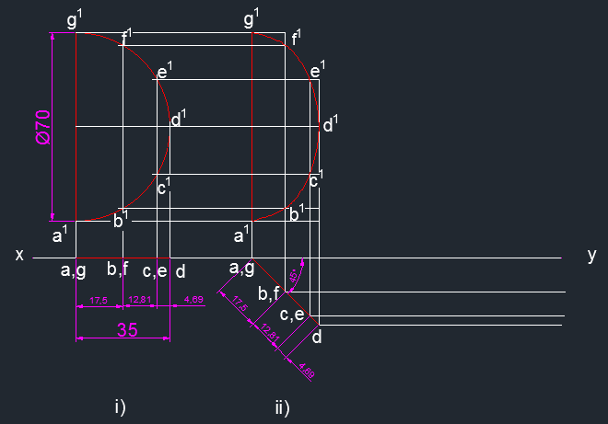
13. Draw horizontal locus lines from first stage front view a‘, b‘, c‘, d‘, e‘, f‘, g‘ using Line command L.
14. Draw a line joining the intersection points of a‘, g‘ using Line command L.
15. Draw a spline joining the intersection points a‘, b‘, c‘, d‘, e‘, f‘, g‘ using SPL command.
16. Mark a‘, b‘, c‘, d‘, e‘, f‘, g' using MTEXT command.

Slide 44
Third Stage
17. Mark the horizontal and vertical dimensions in second stage front view at every point
18. Draw locus lines from Second Stage Top view using Line command L.
19. Copy second stage front view shortest shape of semi circle using Copy command CO.
20. Rotate the copied semi circle at an angle of 150° from xy line using RO command. Mark a‘, b‘, c‘, d‘, e‘, f‘, g' using MTEXT command.
21. Create points on the line with lengths equal to vertical dimensions using Point command PO. Change the dimensions using Parametric – Dimensional Constraints – Aligned.
Offset the line with distances equal to horizontal dimensions using Offset command O.
Draw lines from points to the intersection points of semi circle and offset lines using Line command L.
Dimension using DIMALI command.

Slide 45
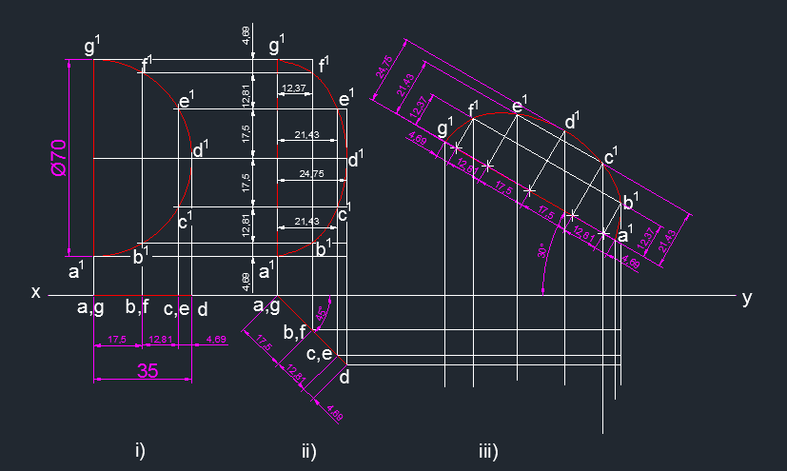

Slide 46
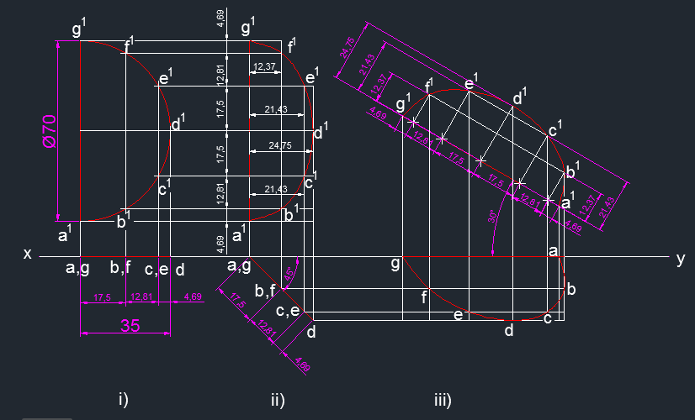
Draw projection and locus lines using Line command L.
Draw spline joining intersection points of projection and locus lines using SPL command.
. Mark a, b, c, d, e, f, g using MTEXT command at the respective intersection points.

Slide 47
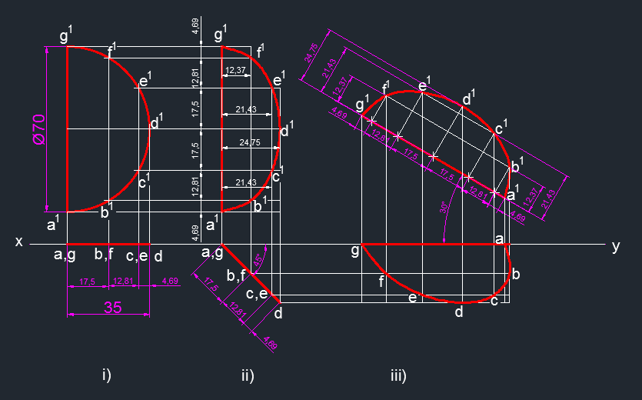

Slide 48
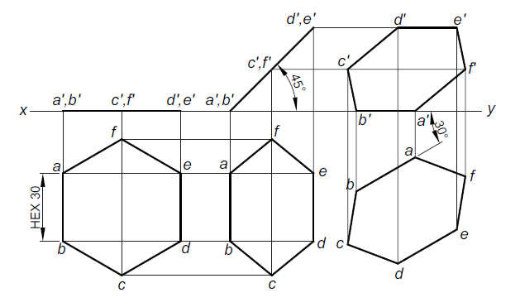
PLANE INCLINED TO BOTH THE REFERENCE PLANES (edge in the H.P.)
14. A hexagonal plane of side 30 mm has an edge on the H.P. Its surface is inclined at 45° to the H.P. and the edge on which the plane rests is inclined at 30° to the V.P. Draw its projections.

Slide 49
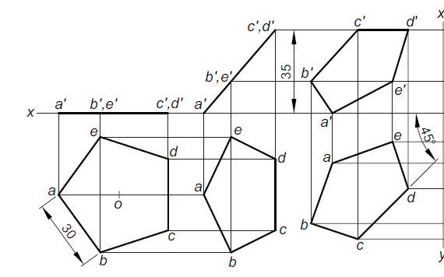
PLANE INCLINED TO BOTH THE REFERENCE PLANES (edge in the H.P.)
15. A pentagonal plane of side 30 mm is resting on a corner in the H.P. The side opposite to the corner in the H.P. is parallel to and 35 mm above H.P. and inclined at 45° to the V.P. Draw its three principal views.

Slide 50
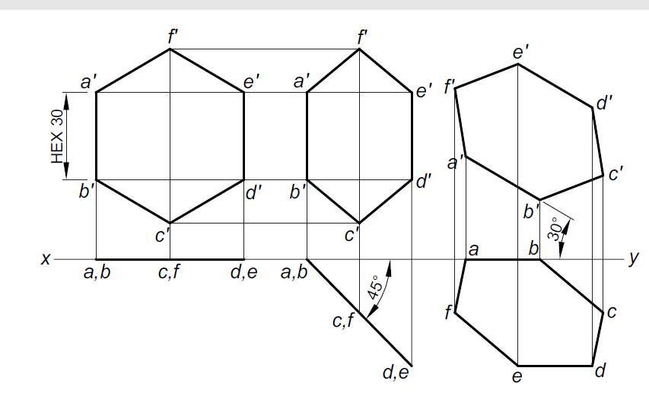
PLANE INCLINED TO BOTH THE REFERENCE PLANES (edge in the H.P.)
16. A hexagonal plane of side 30 mm has an edge in the V.P. The surface of the plane is inclined at 45° to the V.P. and the edge on which it rests is inclined at 30° to the H.P. Draw its projections.

Slide 51
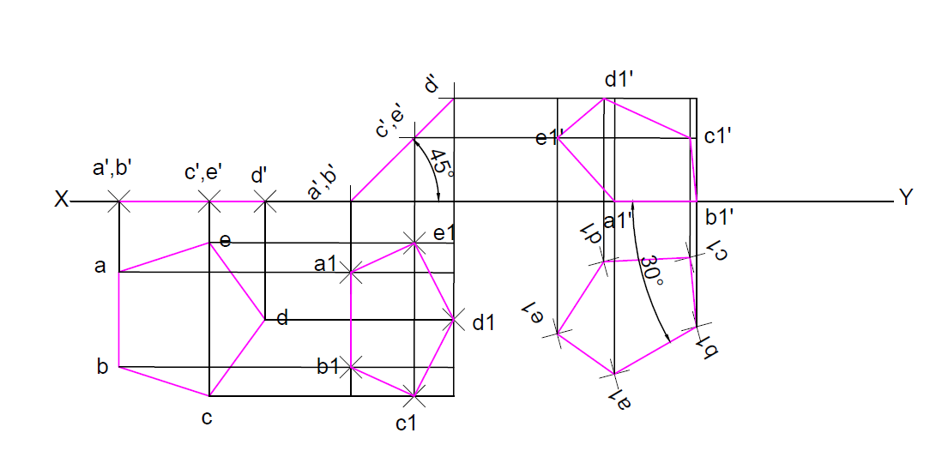
PLANE INCLINED TO BOTH THE REFERENCE PLANES (edge in the H.P.)
17. A pentagonal plane with a 30mm side rests on the H.P. on the edge such that the surface is inclined 45deg to the H.P. and the edge on which its rests is inclined at 30deg to the V.P. Draw its projections.

Slide 52
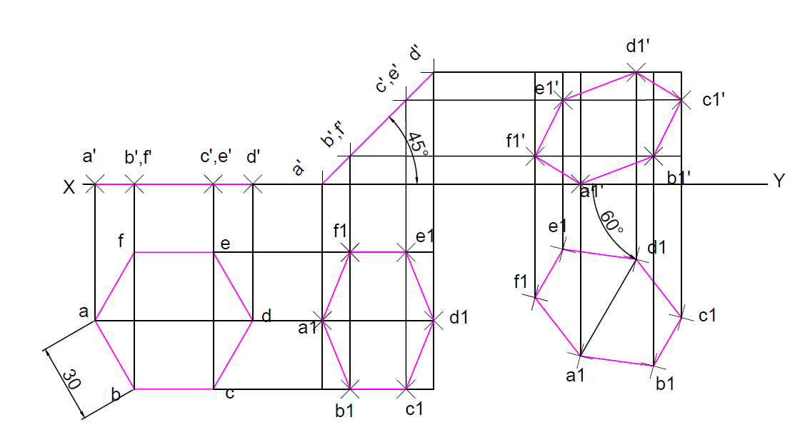
PLANE INCLINED TO BOTH THE REFERENCE PLANES (edge in the H.P.)
18. A hexagonal plane of side 30mm has a corner on the H.P. Its surface is inclined at 45deg to the H.P. and the corner on which the plane rests is inclined at 60deg to the V.P. Draw its projections.

Slide 53
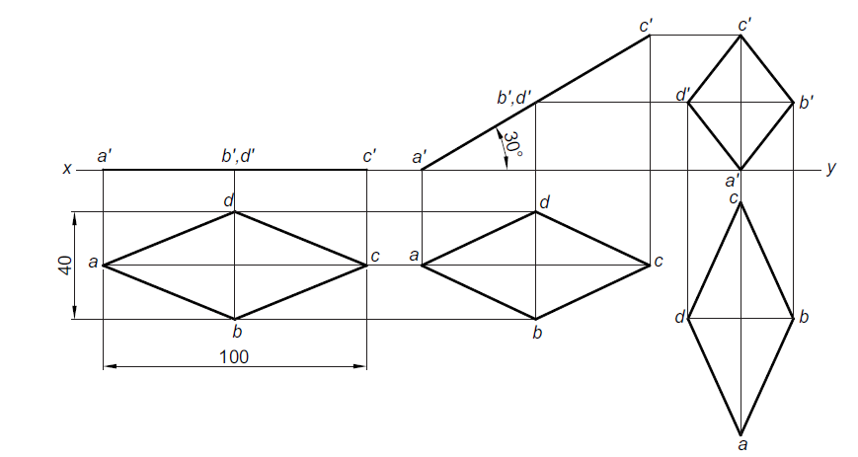
PLANE INCLINED TO BOTH THE REFERENCE PLANES (edge in the H.P.)
19. The diagonals of a rhombus measure 100 mm and 40 mm. The longer diagonal is inclined at 30° to H.P. with an end in H.P. and the smaller diagonal is parallel to both the principal planes. Draw its projections.

Slide 54
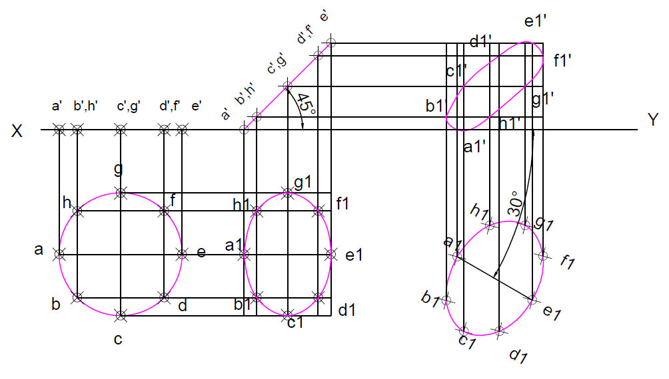
PLANE INCLINED TO BOTH THE REFERENCE PLANES (edge in the H.P.)
20. Draw the projections of a circular plane of diameter 50mm resting on a point A of the circumference on the H.P. Such that its surface is inclined 45deg to the H.P. and (a) the top view of the diameter through point A is inclined at 30deg to the V.P.

